Slide 1
Capstone
Team Bug Washers:
Jaimin Hadvani - 202301146
Het Ladani - 202301102
Pal Kaneria - 202301021
Utsker Dhameliya - 202301083

Slide 2
Problem P-8 :
Develop a spell checker application that checks the spelling of words in a given text document, utilizing data structures like hash tables or trie for efficient dictionary storage and lookup. After highlighting the misspelled words, with the user’s approval, replace them with the correct spellings.

Slide 3
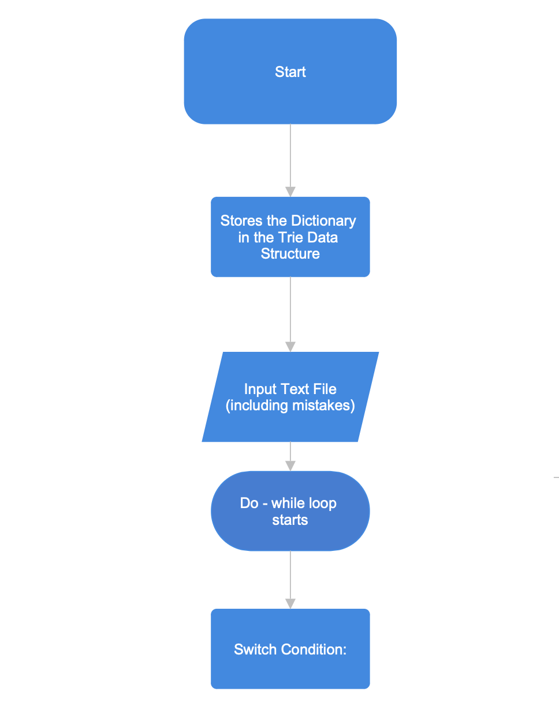
Algorithm :

Slide 4
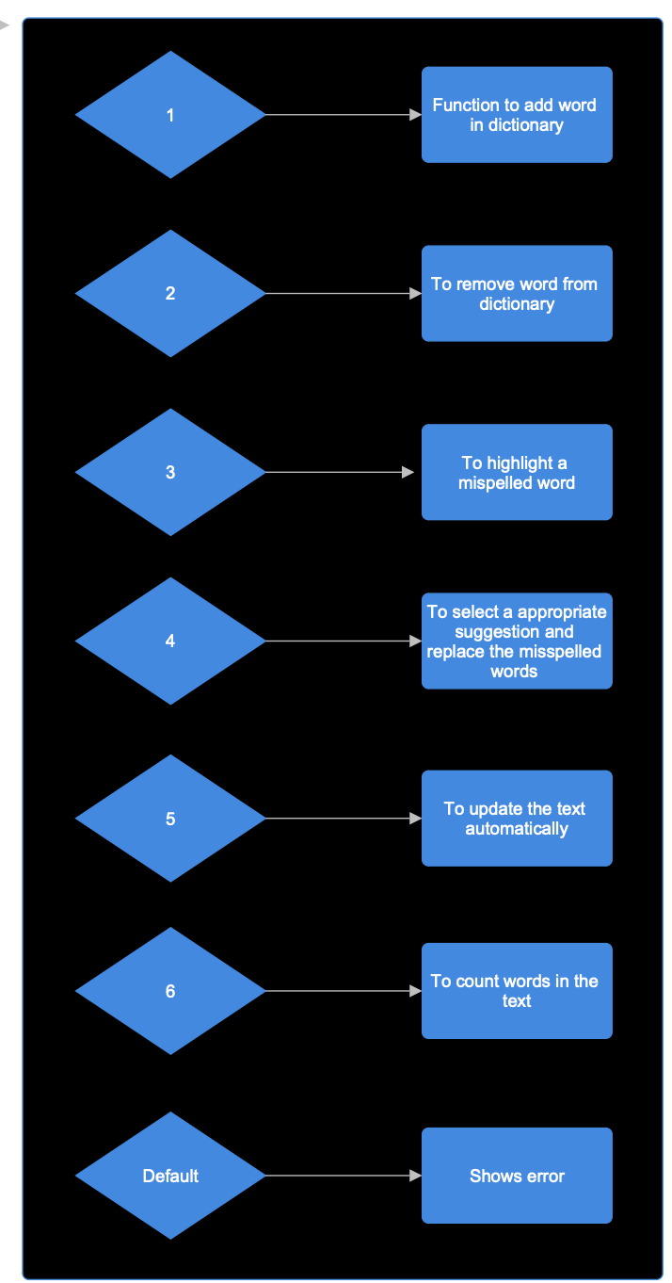
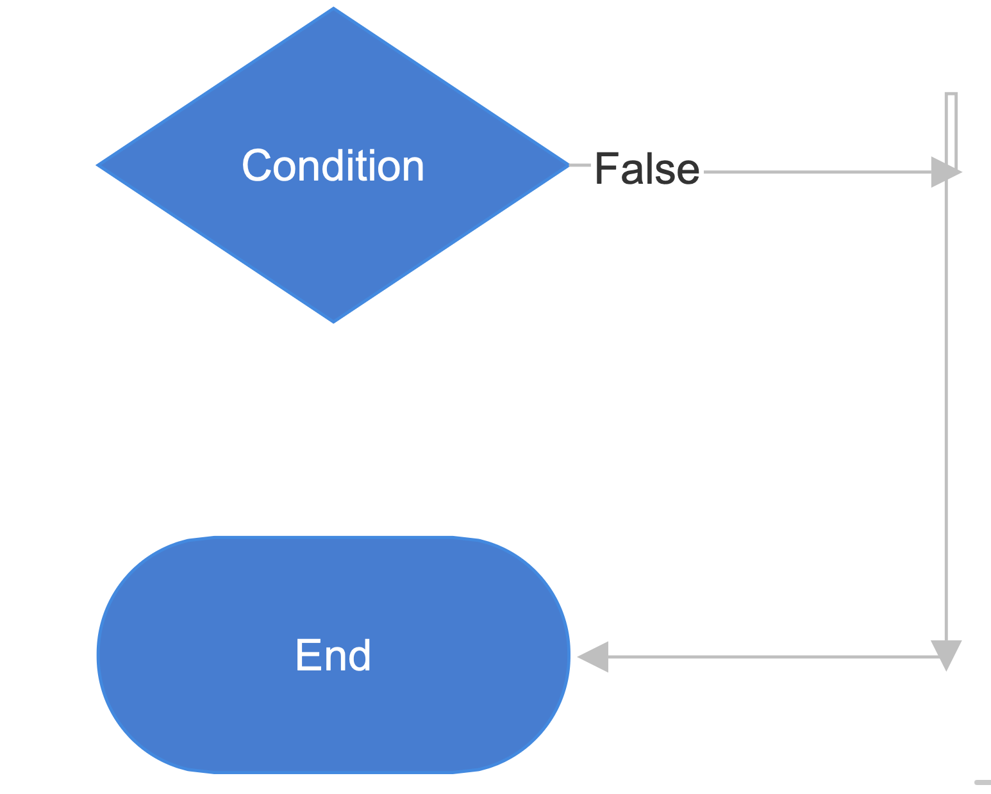
True

Slide 5
Why we have chosen Trie data structure?
Trie is a tree-based data structure used for efficiently storing and searching for strings in a set of data.
● One of the advantages of using trie over other data structures is its property of fast searching operation i.e we can search for a key by traversing down the tree from the root and the time of searching is directly proportional to the length of the key which makes the data structure efficient to search keys in large dataset.
● Secondly, it is space efficient because they store only the characters that are present in the keys, and not the entire key itself. Hence the space complexity of the trie depends on the number of nodes present in a trie. Moreover, deletion is easier with tries where it takes constant time.

Slide 6
Time Complexity:
Addword(for adding a word in a dictionary), Removeword(for removing a word from the dictionary), SearchWord(for searching a word in a dictionary). The time complexity of these functions is as below:
1) Adding a word - O(k), where k is a length of string which is constant,hence it almost takes constant time for adding a word in a dictionary.
2) Removing a word - O(k), where k is again length of string which is constant, hence removing a word from dictionary also happens in almost constant time.
3) Suggesting a word - O(n) , n is number of strings . Suggesting a word takes more time than adding or removing a word in a dictionary.

Slide 7
Space Complexity:
The space complexity can be analyzed in terms of the space required for storing the dictionary in the trie data structure, additional variables, and the space used during runtime.
Dictionary Trie: The space complexity of the trie data structure depends on the number of words and the length of the words in the dictionary.
Additional Variable: The SpellChecker class contains additional variables such as rootNode, endOfWord flag, vec vector, suggestions vector, line, word, wordcount, add, number and remove. However, the space occupied by these variables is constant or negligible compared to the trie structure.

Slide 8
Space Complexity:
3) Runtime Space: During runtime, space is used for function call stacks and temporary variables, which is also negligible as compared to the trie structure.
Thus the space complexity of the program will be O(n*m):
Where: n is the number of words in dictionary
m is average length of the word.

Slide 9
Link to the Recording:
https://drive.google.com/file/d/1xFTQx68rN_x2vchxhikGGDbFjsw32YjU/view?usp=sharing

Slide 10
Thank You!

